Slide 1


Database System [Relational Model in DBMS]

Slide 2
Relational model can represent as a table with columns and rows.
Each row is known as a tuple.
Each table of the column has a name or attribute.
Relational Model in DBMS

Slide 3
It contains a set of atomic values that an attribute
can take.
Domain:
It contains the name of a column in a particular
table.
Each attribute Ai must have a domain, dom(Ai)
Relational Model in DBMS
Attribute:
In the relational database system, the relational instance is represented by a finite set of tuples.
Relation instances do not have duplicate tuples.
Relational
instance:

Slide 4
Relational schema:
A relational schema contains the name of the relation and name of all columns or attributes.
Relational Model in DBMS
In the relational key, each row has one or more attributes.
It can identify the row in the relation uniquely.
Relational key:

Slide 5
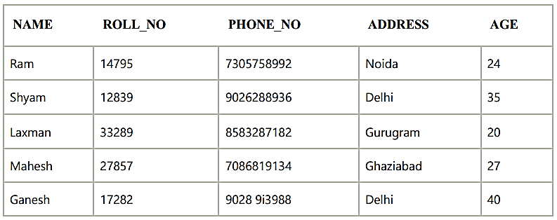
STUDENT Relation
Relational Model Example
In the given table, NAME, ROLL_NO, PHONE_NO, ADDRESS, and AGE are the attributes.
The instance of schema STUDENT has 5 tuples.
t3 = <Laxman, 33289, 8583287182, Gurugram, 20>

Slide 6
Name of the relation is distinct from all other relations.
Each relation cell contains exactly one atomic (single) value
Properties of Relations
Each attribute contains a distinct name
Attribute domain has no significance
tuple has no duplicate value
Order of tuple can have a different sequence

